Slide 1
From Static to Dynamic: Leveraging Short-Lived SAS tokens for Better Security in Microsoft Azure
Sakshi Nasha
Software Engineer II - Cohesity

Slide 2
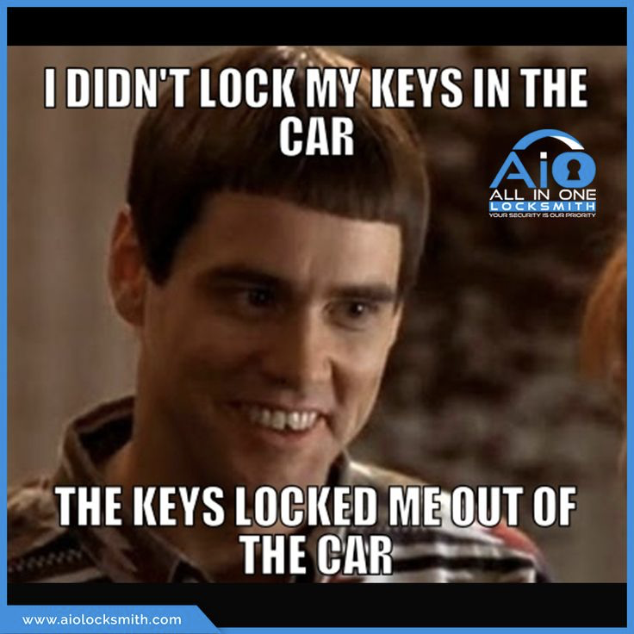
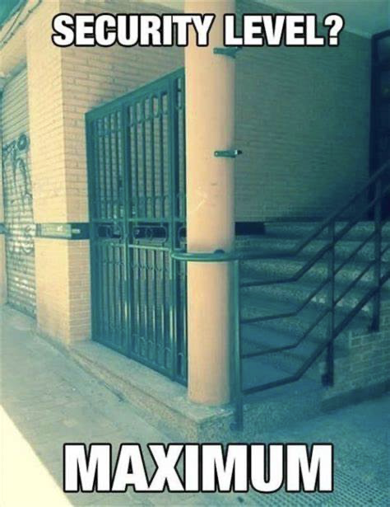
How much security is too much security for you ?

Slide 3
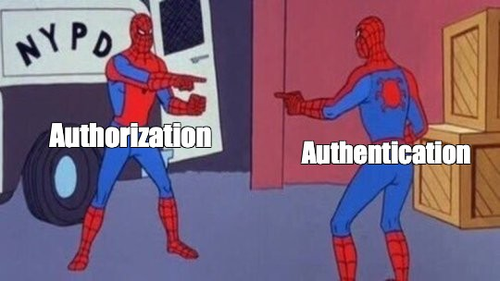

Slide 4
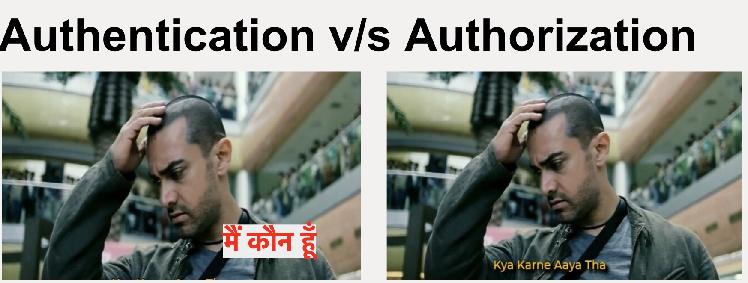
One step at a time

Slide 5
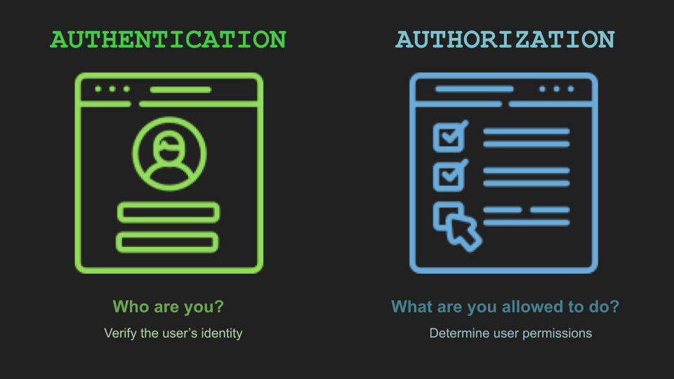

Slide 6
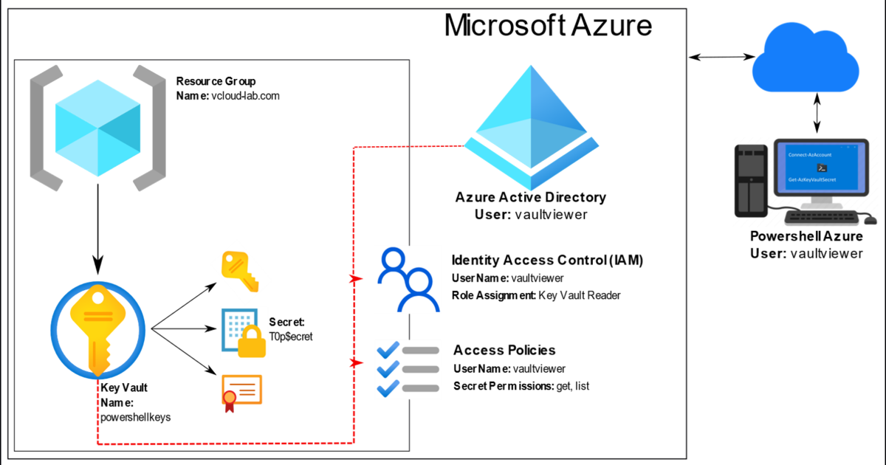
Traditional Way of generating Azure Secret keys

Slide 7
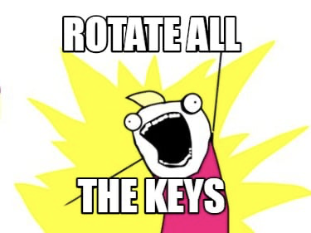
Disadvantages of using Standard Credentials in your application
These standard credentials are long lived in nature.
If compromised, they give attackers ample time to exploit the application.
If they are stolen it would be a nightmare to discern which operations are legitimate.
Thus, the only fail-safe choice is to cumbersomely rotate the keys and redistribute to customers. This is often overlooked action and adds extra pain for the DevOps.

Slide 8
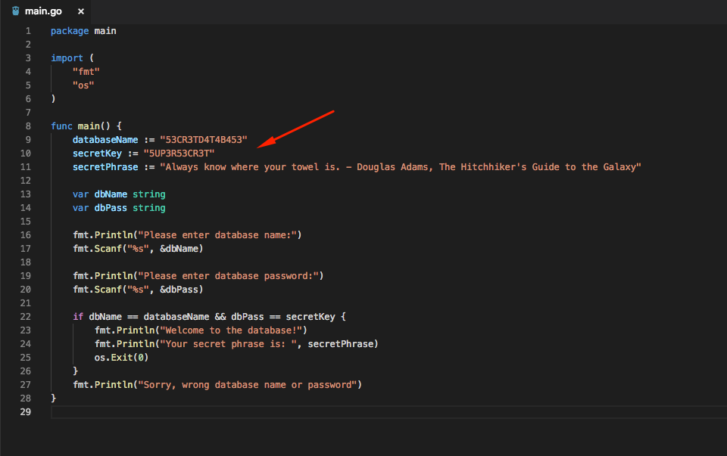
Hardcoding secrets in the code

Slide 9
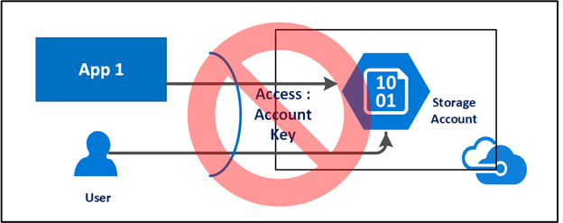
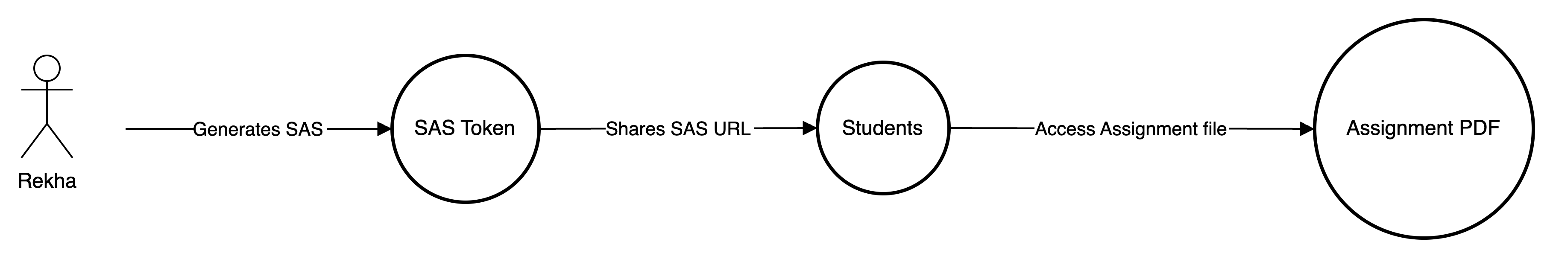
Introduction to Short Lived SAS tokens
Scenario

Slide 10

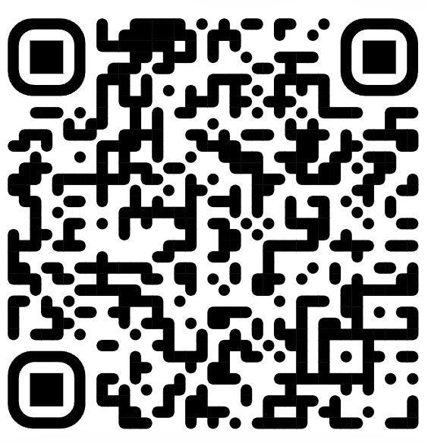
What are SAS ?
A shared access signature (SAS) is a URI that grants restricted access rights to Azure Storage resources.
With a SAS, you have granular control over how a client can access your data. For example:
What resources the client may access.
What permissions they have to those resources.
How long the SAS is valid.

Slide 11
Working of SAS ?
SAS is token that is appended to the URI Token contains a special set of query parameters that indicate how the resources may be accessed by the client. The SAS token: Everything after the ? is the temporary key.
sv : Version of the SAS. sr : Signed Resource (Blob, File, table, Queue)
se : The expiration time for the token.
sp=r: What they can do (in this case, just read).
sig=abcdefg12345: The security signature to make sure it’s valid.

Slide 12
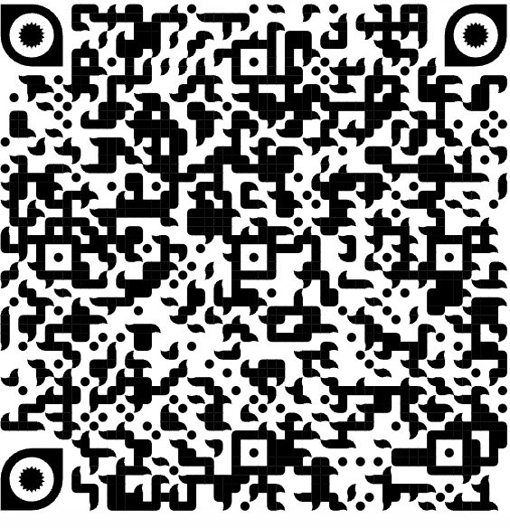
Types of SAS Tokens
Account SAS
Service SAS
User Delegation SAS

Slide 13
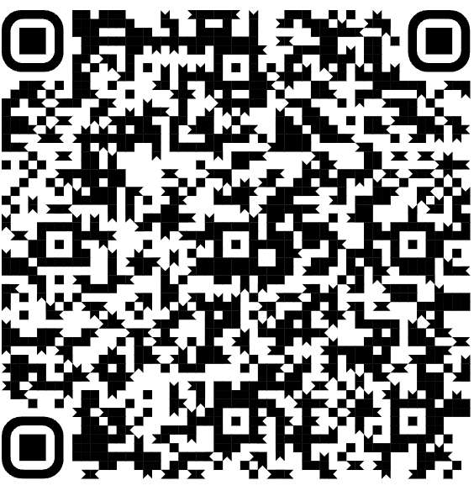
Decision Tree for selecting SAS token Type

Slide 14
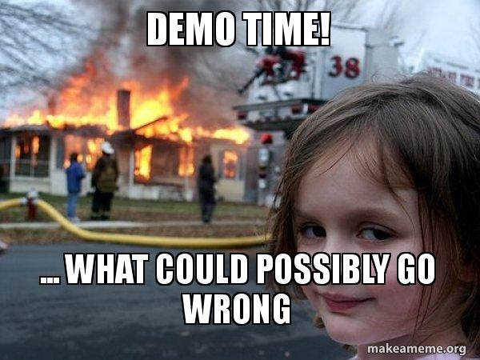
Let the adventure began
Wish me luck !!

Slide 15
1. Azure CLI Access file : https://github.com/Sakshi-10/Az-SAS-token/blob/main/Program.cs 2. Azure SDK from azure.storage.blob import generate_container_sas

Slide 16
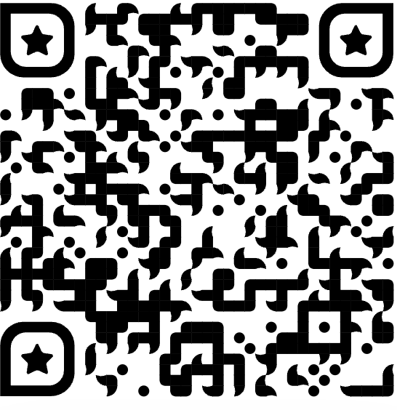
Access the Code

Slide 17
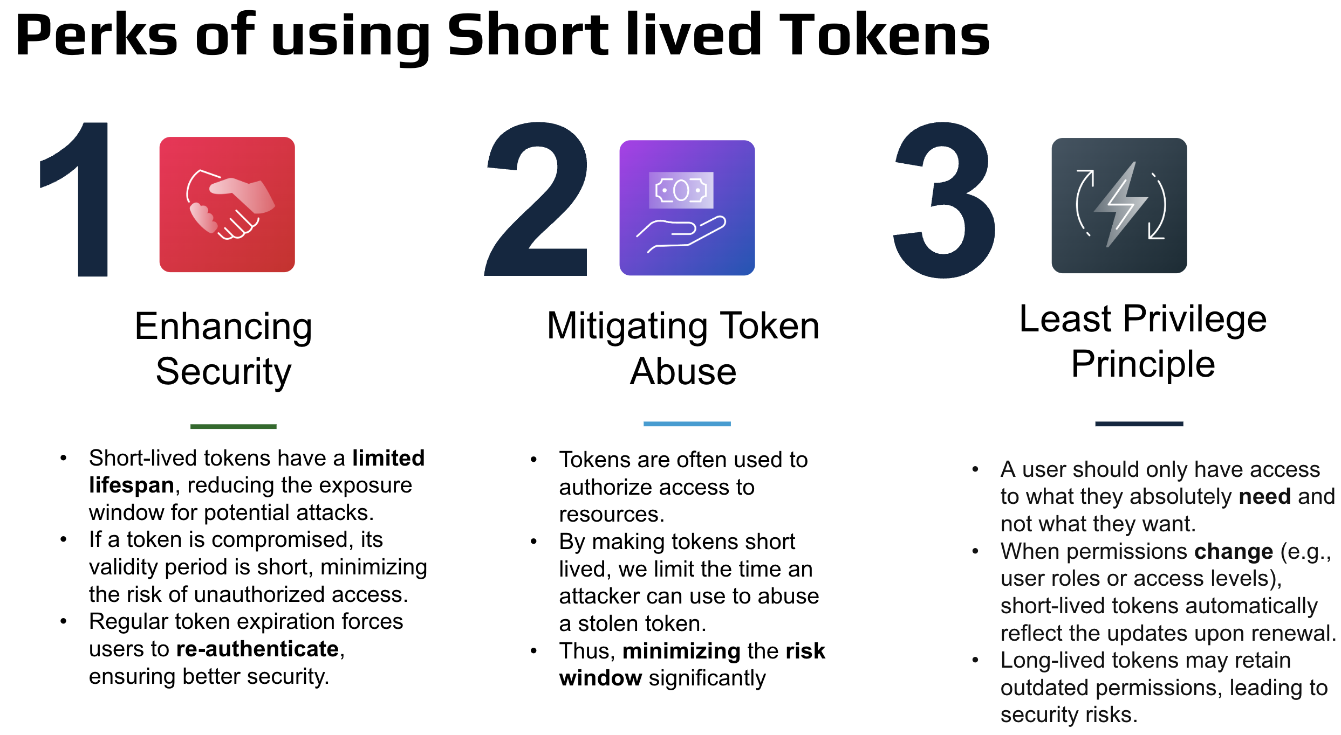

Slide 18
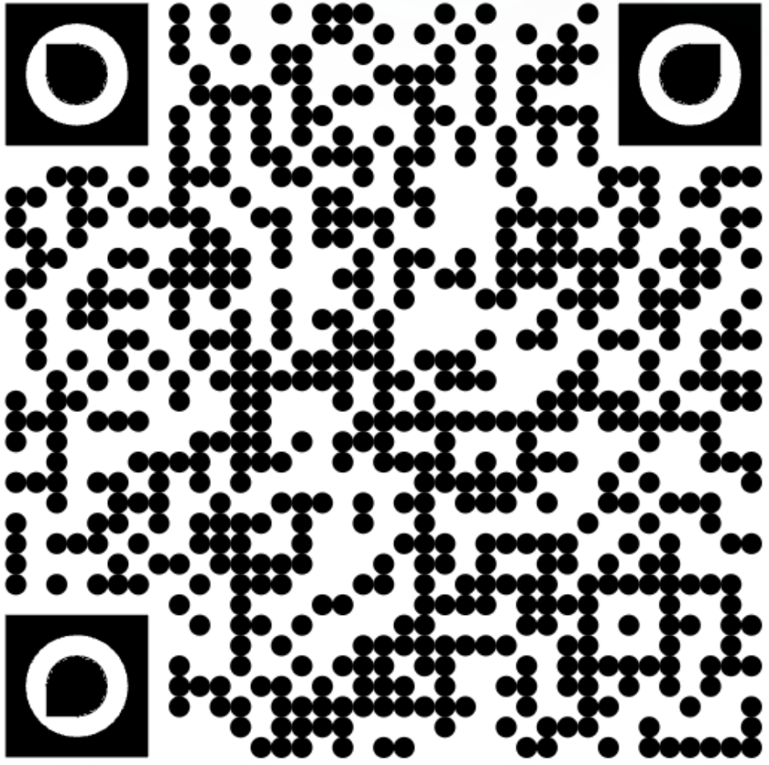
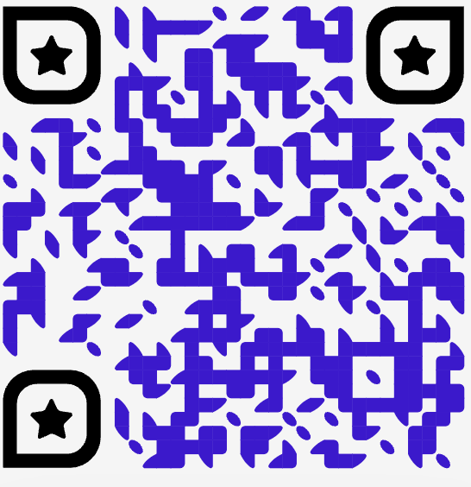

Thank You!
Connect with me 🙋🏻‍♀️
Guidance

Slide 19
Q&A, Bring it on !

